Slide 1
Weekly Meeting
July 16, 2020

Slide 2
Outline
HipMCL component breakdown by runtime
HipMCL Resident Set Size (RSS) analysis
Discussion on Google’s TPU?

Slide 3
Description of the Dataset
Dataset | Number of Vertices (million) | Number of Edges (million)
Renamed subgraph5 | 0.58 | 67
subgraph5 | 1.79 | 82
archaea | 1.6 | 205
Eukarya | 3.2 | 360
subgraph4 | 3.8 | 327
Notes:
1. Renamed_subgraph5 – /global/project/projectdirs/m1982/www/HipMCL/subgraphs-1103/Renamed_subgraph5_set1103_MMSeqs_Qcov065_Hcov065_SBS_all
2. subgraph5 - /global/project/projectdirs/m1982/www/HipMCL/subgraphs/subgraph5_iso_vs_iso_30_70length_ALL.m100.indexed.mtx
3. subgraph4 - /global/project/projectdirs/m1982/www/HipMCL/subgraphs/subgraph4_iso_vs_iso_30_70length_ALL.m100.indexed.mtx

Slide 4
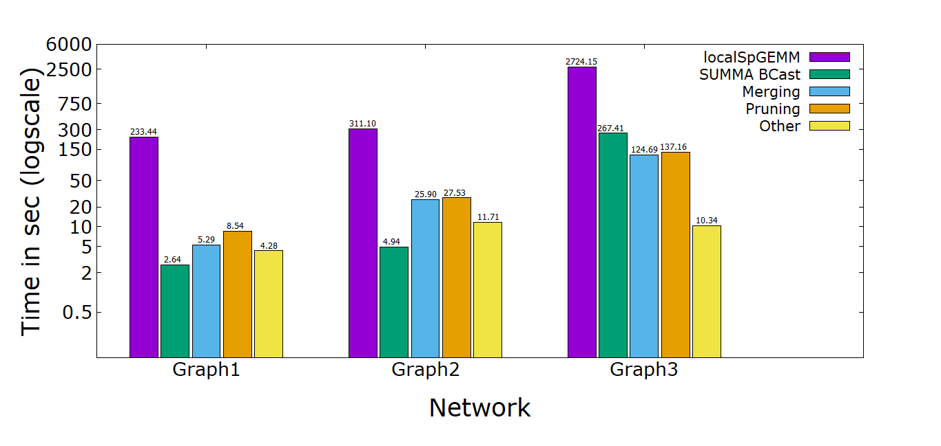
HipMCL Components Breakdown
Note: All the 3 graphs executed on 4 MPI processes in 4 different compute nodes
Notes:
Graph1 – renamed_subgraph5
Graph2 - subgraph5
Graph3 – subgraph4

Slide 5
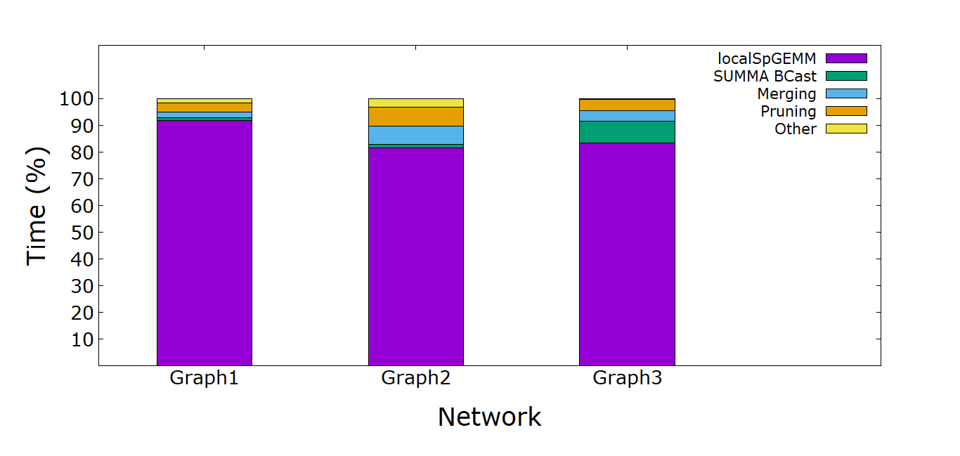
HipMCL Components Breakdown
Note: All the 3 graphs executed on 4 MPI processes in 4 different compute nodes
Notes:
Graph1 – renamed_subgraph5
Graph2 - subgraph5
Graph3 – subgraph4

Slide 6
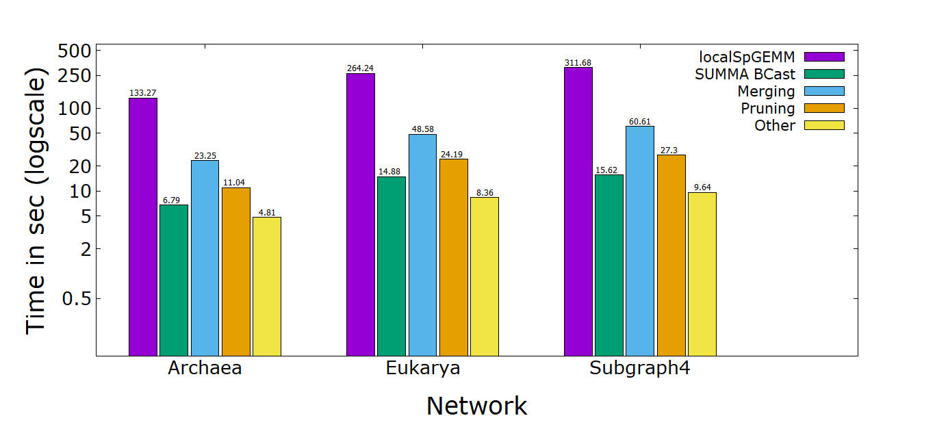
HipMCL Components Breakdown
Note: All the 3 graphs executed on 16 MPI processes in 16 different compute nodes

Slide 7
HipMCL Resident Memory Size (RSS) Analysis
Dataset | #Processes | Average RSS (GB) | Max RSS (GB)
renamed_subgraph5 | 4 | 0.0095 | 12.44
subgraph5 | 4 | 0.29 | 33.77
archaea | 4 | 0.33 | 36.57
eukarya | 4 | 0.29 | 33.29
subgraph4 | 4 | 0.029 | 29.36

Slide 8
HipMCL Resident Memory Size (RSS) Analysis
Dataset | #Processes | Average RSS (GB) | Max RSS (GB)
renamed_subgraph5 | 16 | 3.71 | 4.95
subgraph5 | 16 | 0.15 | 17.61
archaea | 16 | 0.15 | 17.12
eukarya | 16 | 0.34 | 34.77
subgraph4 | 16 | 0.33 | 36.64

Slide 9
Google’s TPU (ASIC-based Tensor Processing Unit)
Google’s talk: https://www.youtube.com/watch?v=kPMpmcl_Pyw

Slide 10
Observation
Runtime breakdown is behaving as expected
RSS analysis needs more analysis for conclusive remarks

